Slide 1
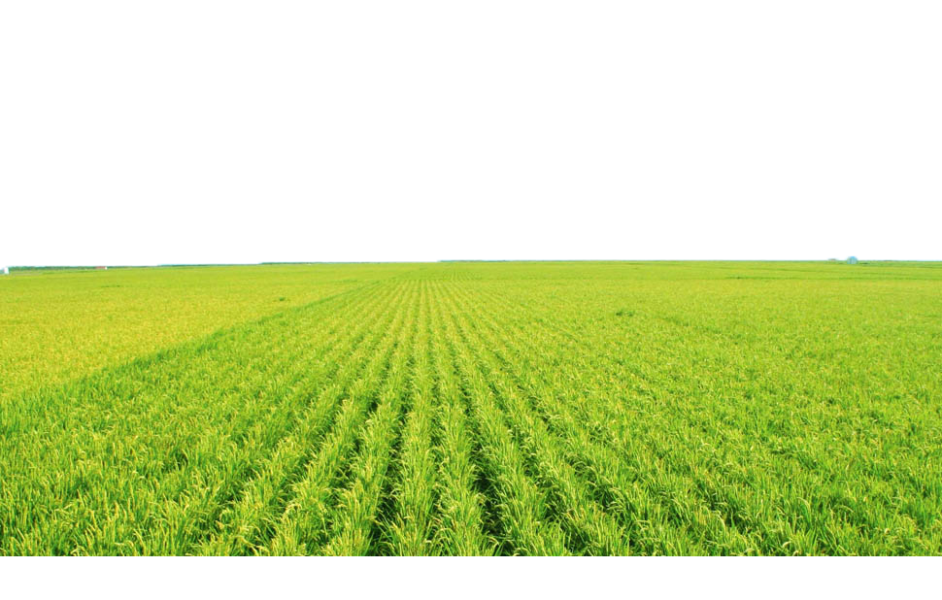
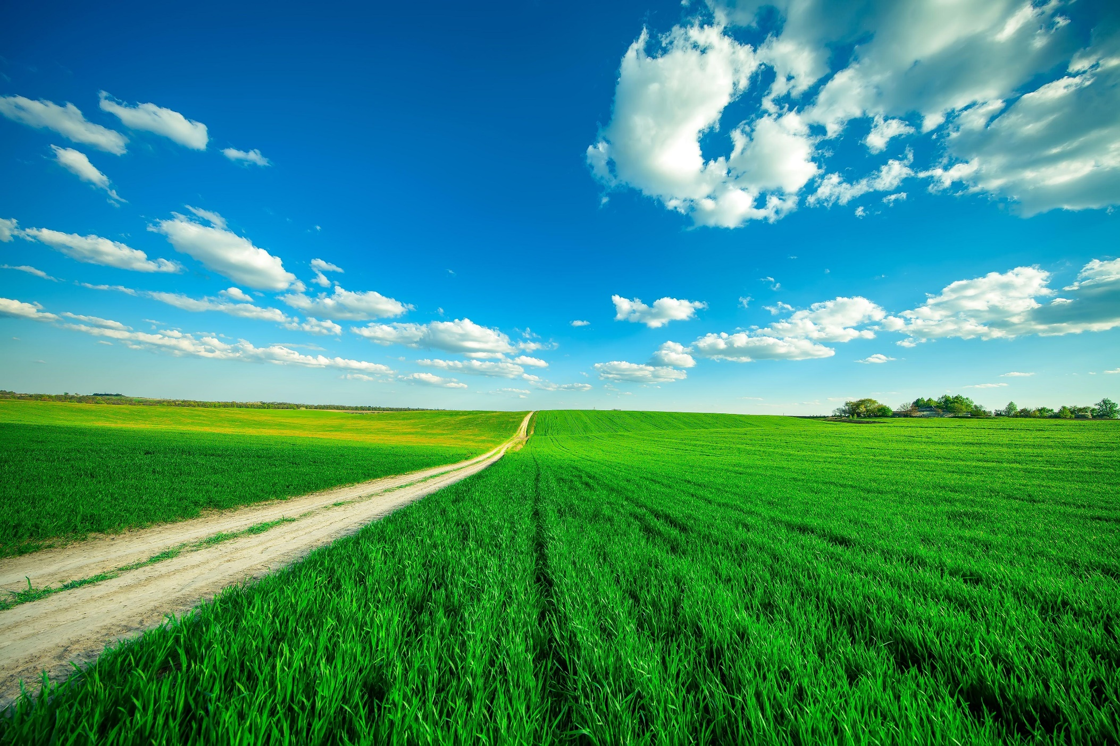



E-KETHA : ENRICHING RICE FARMER’S QUALITY OF LIFE THROUGH A MOBILE APPLICCATION
2022-81

Slide 2

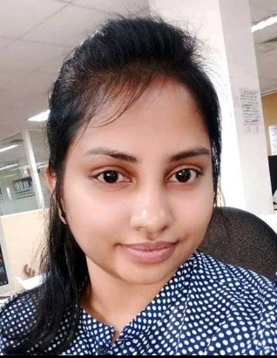

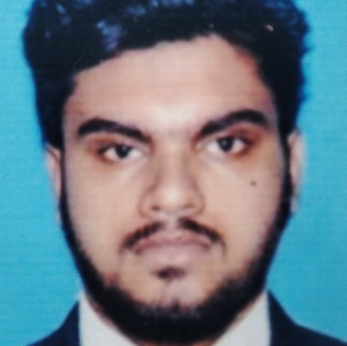

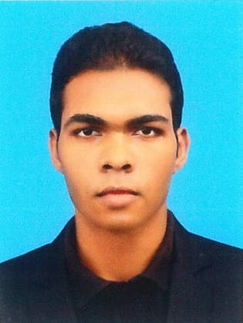
Meet The Team
K.M.Umesh Ranthilina
Member 04
H.H.W.M.Binuka Sihan Paranagama Member 03
Mr. Adeepa Gunarathna Supervisor
Ms. Amali Upeka Gunasinghe
Co-Supervisor
P.Y.D Jayasinghe Member 02
Salika Madhushanka W.J Group Leader

Slide 3
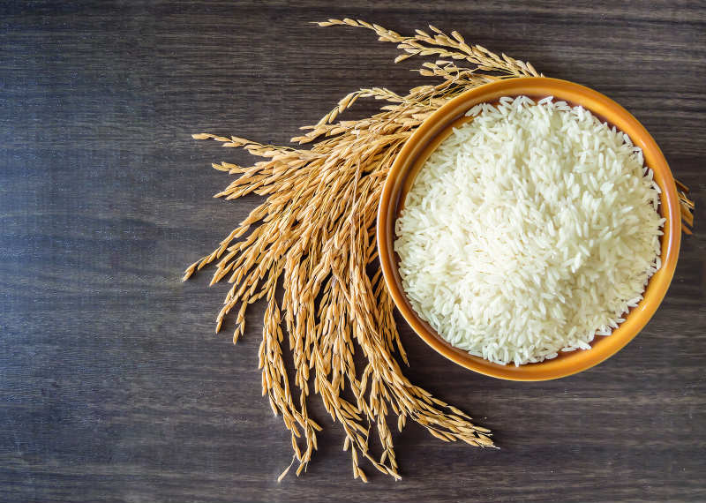
Introduction
Why rice is so important?
Great energy source
Improves the health of nervous system
Can reduce of cancer risks
Prevents obesity
Good source of protein [1]

Slide 4
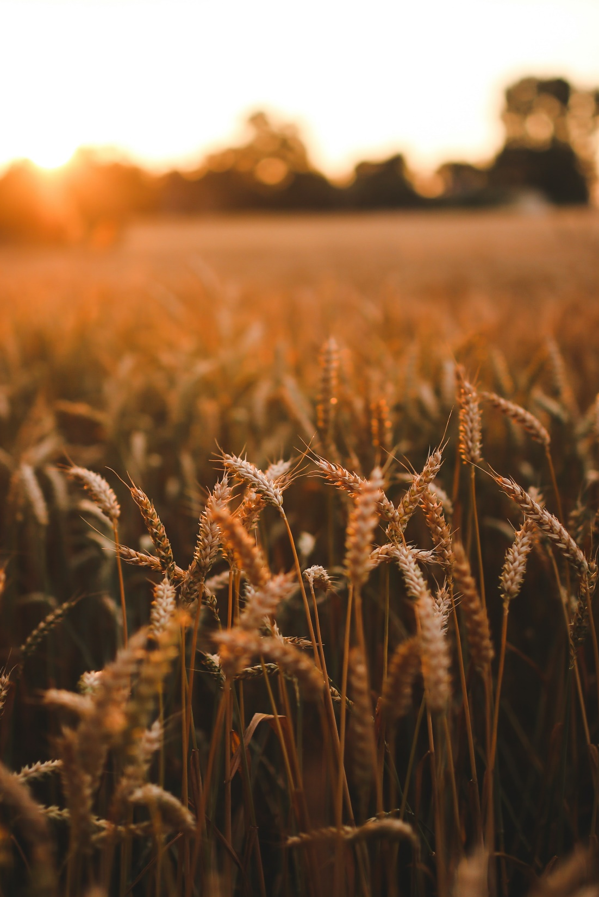

The most important crop in Sri Lanka
Cultivated area – 34%
Family farmers - 1.8 million
Total calories consumed by an average Sri Lankan - 45% [2]

Slide 5
“The government will have to import 800,000 to 1,000,000 MT of rice to meet the shortfall in the domestic supply, at a cost of USD 450 million, according to the URPA chief”.

Slide 6
Research Problem
Common issues Rice farmers face
Pests and Diseases
Weeds
Fertilizer misuse
Growth deficiency
Information sharing
Climate change
Security
Yield/profit prediction
Inventory management

Slide 7
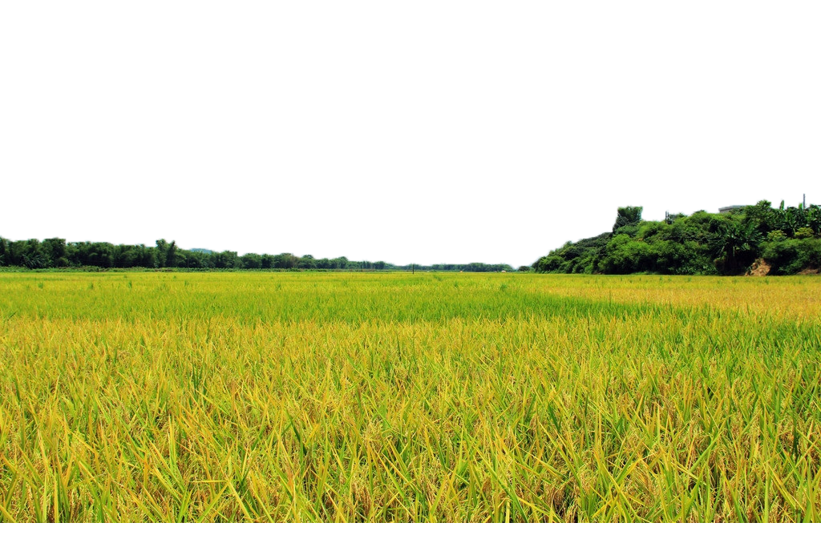
Main Objective
Aid struggling rice farmers by providing proper guidance for the most prevalent issues.

Slide 8
Sub objectives
Fertilizer Management
Identify Pests, Diseases then provide solutions
Identify Weeds and then provide solutions
Growth deficiency and then provide solutions

Slide 9
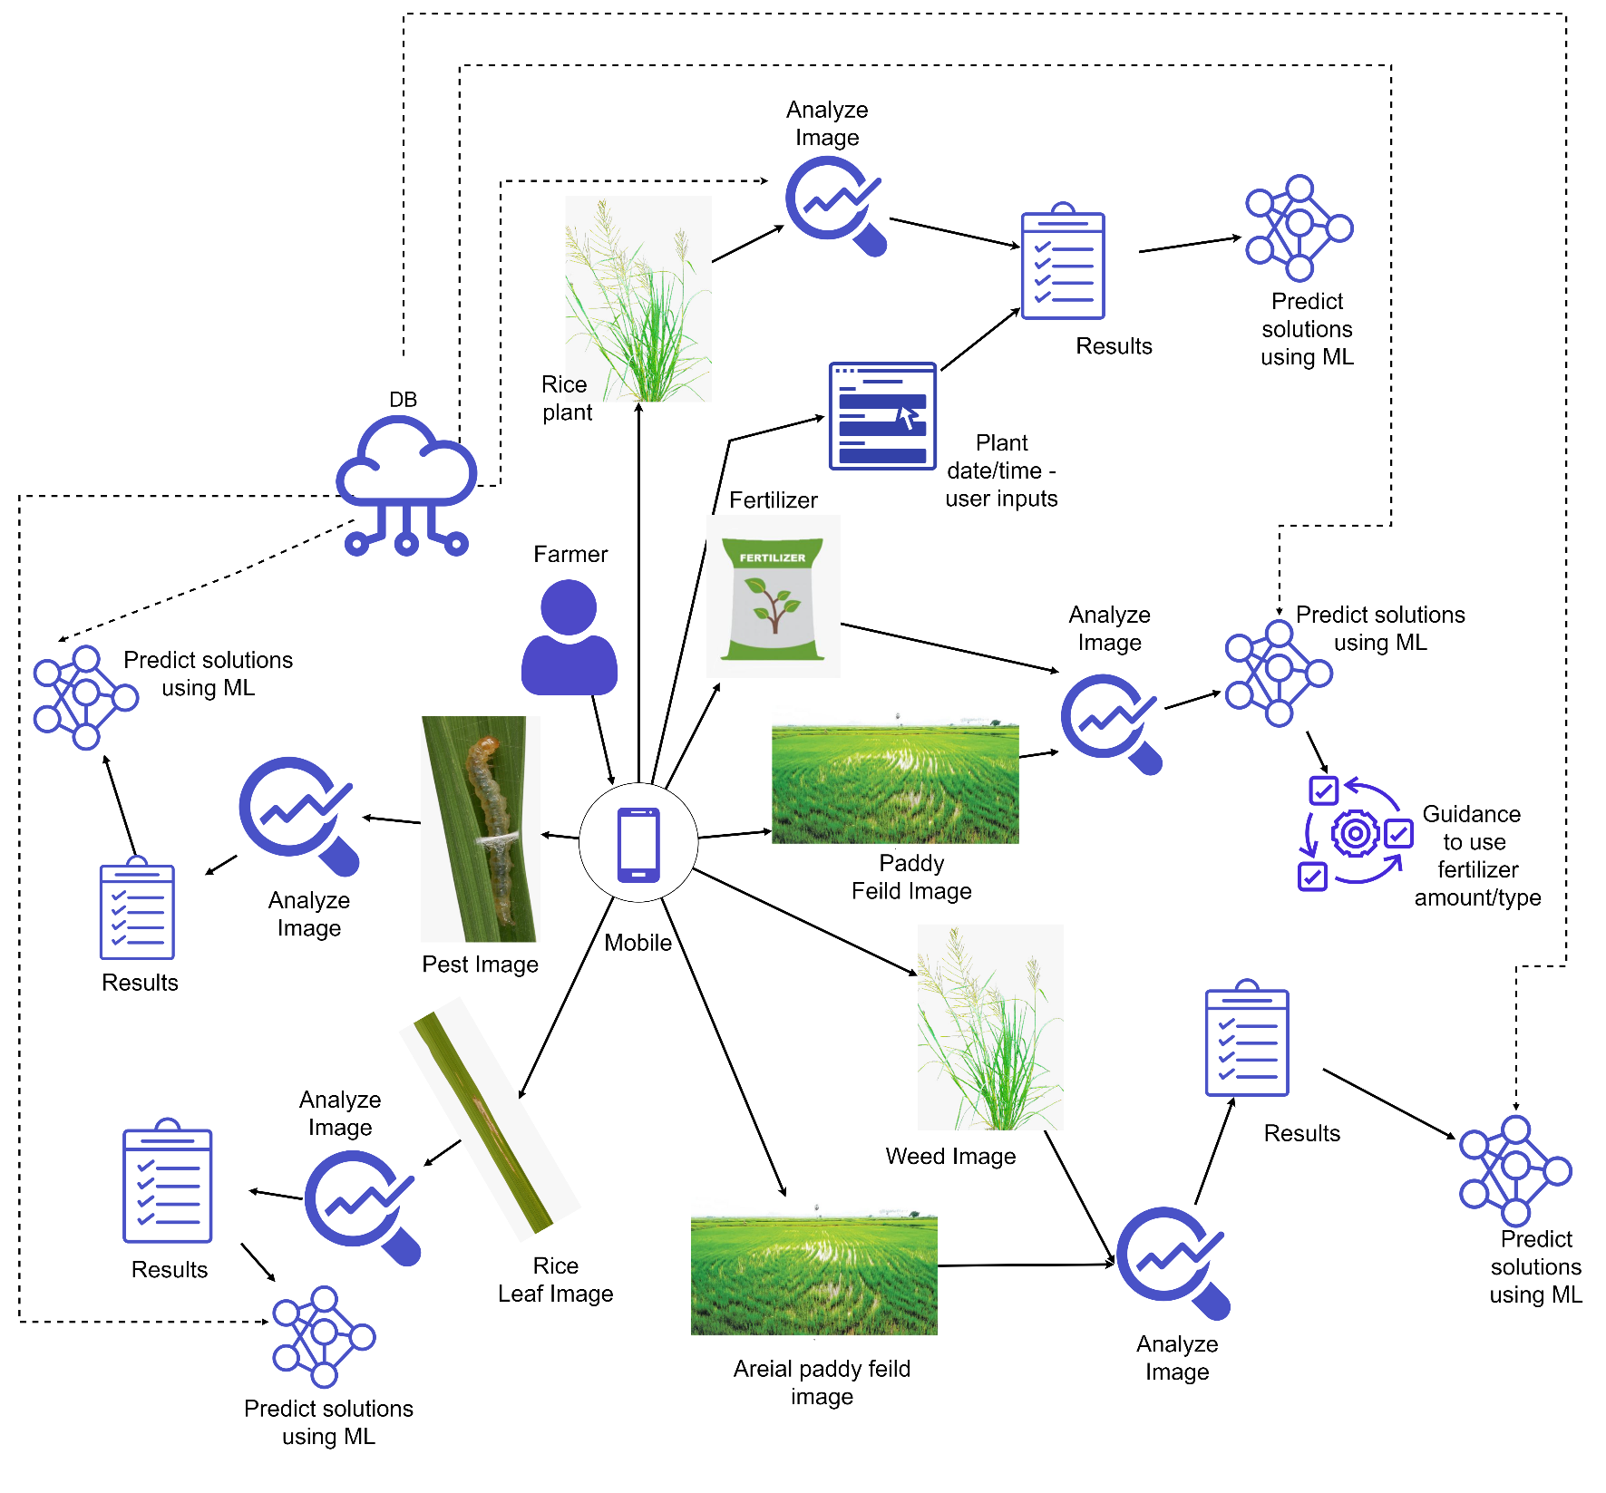
Overall System Diagram

Slide 10
References
[1] The4. “Is Rice Good for You? 10 Amazing Health Benefits of Eating Rice.” Cahokia Rice, www.cahokiarice.com/blogs/health/is-rice-good-for-you-10-amazing-health-benefits-of-eating-rice#:~:text=Rice%27s%20high-fiber%20make%20up%20is%20essential%20for%20reducing. Accessed 31 Jan. 2022.
[2] “Sri Lanka | Economic and Policy Analysis of Climate Change | Food and Agriculture Organization of the United Nations.” Www.fao.org, www.fao.org/in-action/epic/countries/ika/en/#:~:text=Rice%20is%20the%20single%20most. Accessed 31 Jan. 2022.

Slide 11

IT19101620 | Salika Madhushanka W.J
Software Engineering
IT19101620 | Salika Madhushanka W.J | 2022-81

Slide 12
Introduction
Background
Research Gap
Research Problem
Objectives

Slide 13
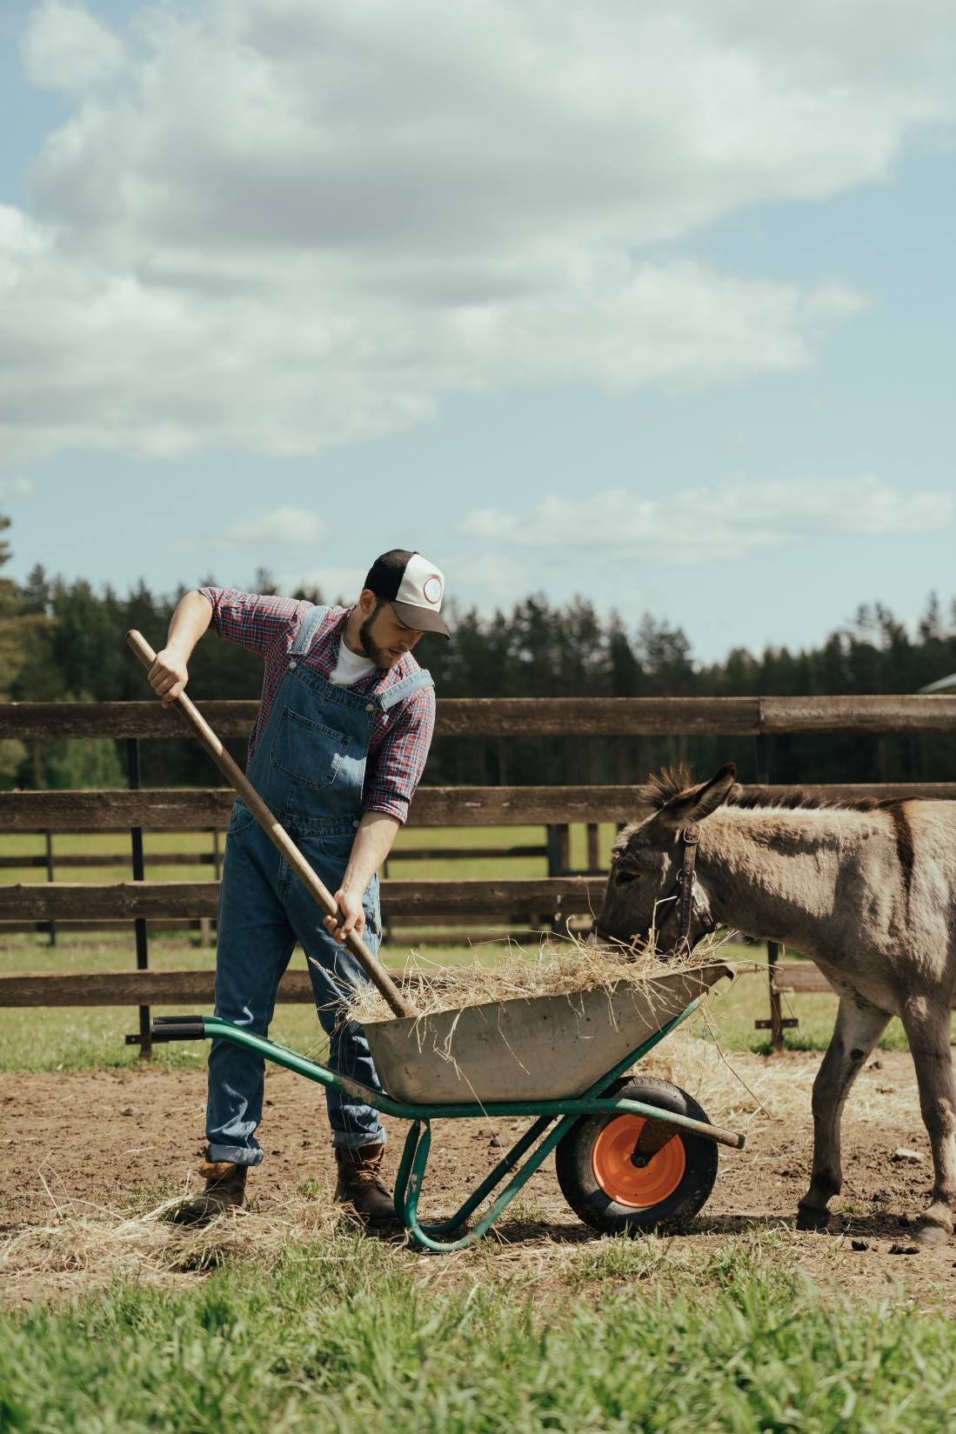
Background
What are the diseases and pests?
How to pests and diseases affect productivity of rice?
Problem in the current use of this technology
[1]
IT19101620 | Salika Madhushanka W.J | 2022-81

Slide 14
Paddy lost after harvest
Parameter | Annual Statics
Annual paddy production in Sri Lanaka | 2014 Yala season – 1,144,929 MT 2014/15 Maha season 2,876,987 MT Total 4,021,916 MT
Post-harvest losses of paddy (approx. 15%) | 603,287 MT
Losses during storage (4-6%) | 160,877 – 241,314 MT
Losses due to insects (80% of storage losses) | 128,701 – 193,051 MT
[2]
IT19101620 | Salika Madhushanka W.J | 2022-81

Slide 15
Research Gap
Task | Agrio [3] | Crop Farmers [4] | Diseases and Wheat [6] | Pest Identification[7] | Pest & Crop [8] | E-Ketha
Pre preparation needed | ✓ | ✗ | ✗ | ✗ | ✗ | ✗
Diagnosis of paddy cultivation. | ✗ | ✓ | ✗ | ✗ | ✗ | ✓
Identify disease that harmful for the cultivation. | ✓ | ✗ | ✓ | ✗ | ✗ | ✓
Give brief description about current situation of the disease. | ✗ | ✗ | ✓ | ✗ | ✗ | ✓
Give Details about treatment of the disease. | ✓ | ✓ | ✗ | ✗ | ✗ | ✓
Identify pests that harmful for the cultivation. | ✗ | ✗ | ✗ | ✓ | ✓ | ✓
Give Details about treatment of the Pests. | ✗ | ✗ | ✗ | ✗ | ✗ | ✓
IT19101620 | Salika Madhushanka W.J | 2022-81

Slide 16
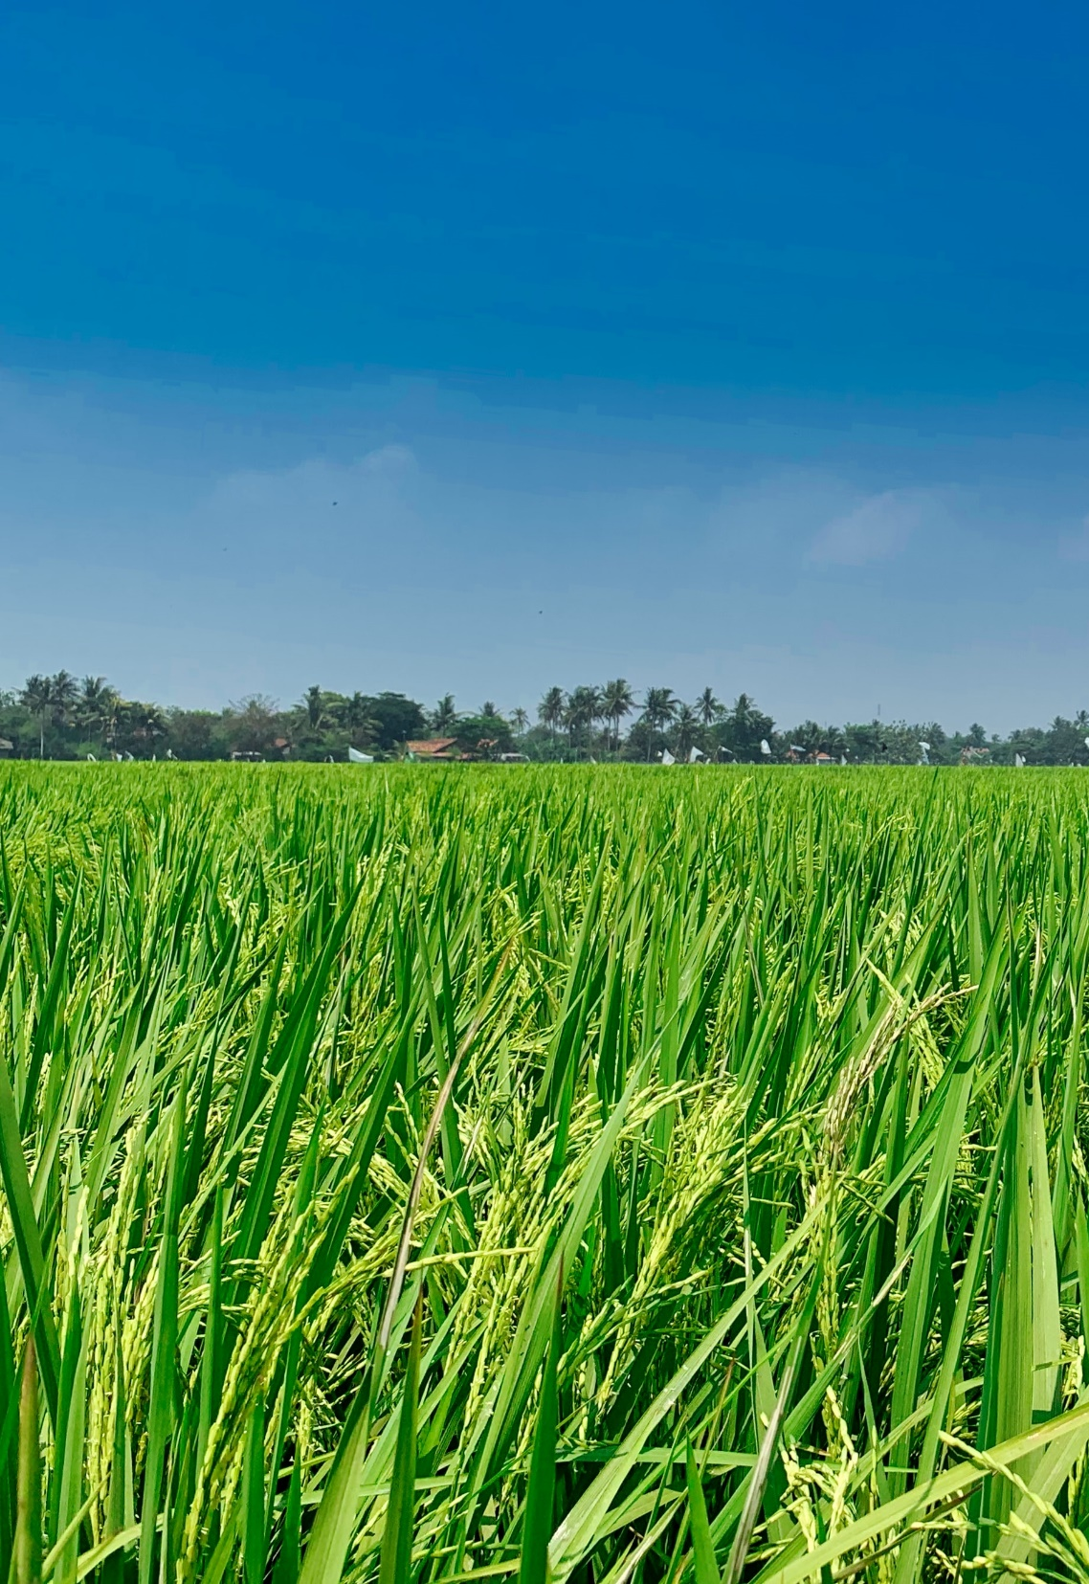
Research Problem
Lack of knowledge when it comes to proper pesticide and handling methods.
New diseases being born frequently.
IT19101620 | Salika Madhushanka W.J | 2022-81

Slide 17
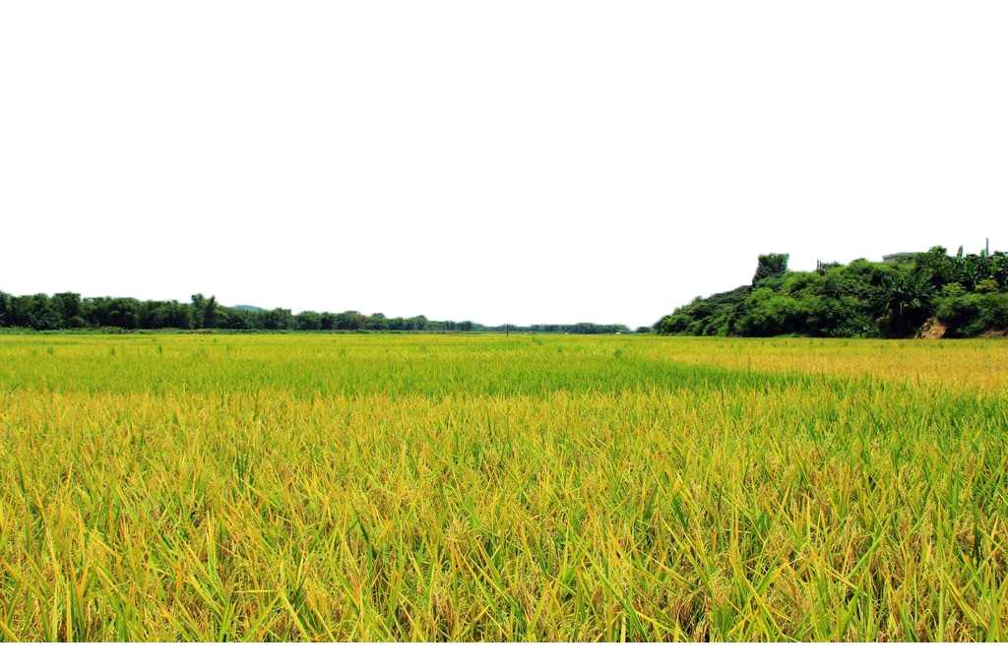
Main Objective
Identification of pests and diseases
and provide solutions

Slide 18
Sub Objectives
Provide solution
Identify the pests or diseases.
Scan the image

Slide 19
Methodology
System Diagram
Technologies
Requirements
WBS

Slide 20
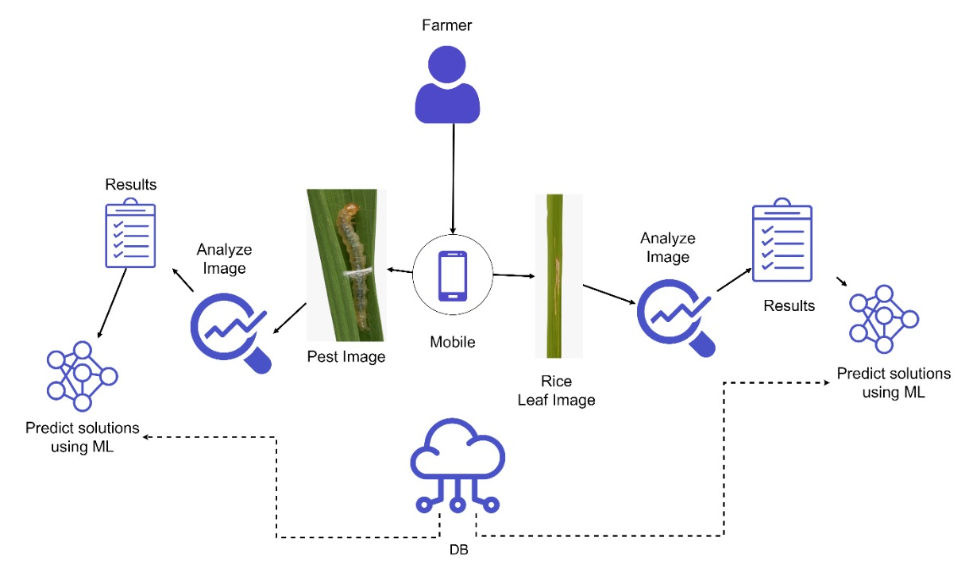
System Diagram
IT19101620 | Salika Madhushanka W.J | 2022-81

Slide 21
Chosen Architectures
Image classification –
CNN
ResNet
DenseNet
FractalNet
Video classification -
R-CNN
YOLO

Slide 22
CNN - Comparison
ResNet | DenseNet
Correlated features | Diversified features
Require more parameters | Require fewer parameters

Slide 23







Technologies

Slide 24

Requirements
System requirements
Average processing power (2GHz)
Average RAM (2GB)
Average storage memory 1GB free
Internet connection
Non-functional requirements
Reliability
Availability
Performance
Personal requirements
Basic smartphone knowledge
IT19101620 | Salika Madhushanka W.J | 2022-81

Slide 25
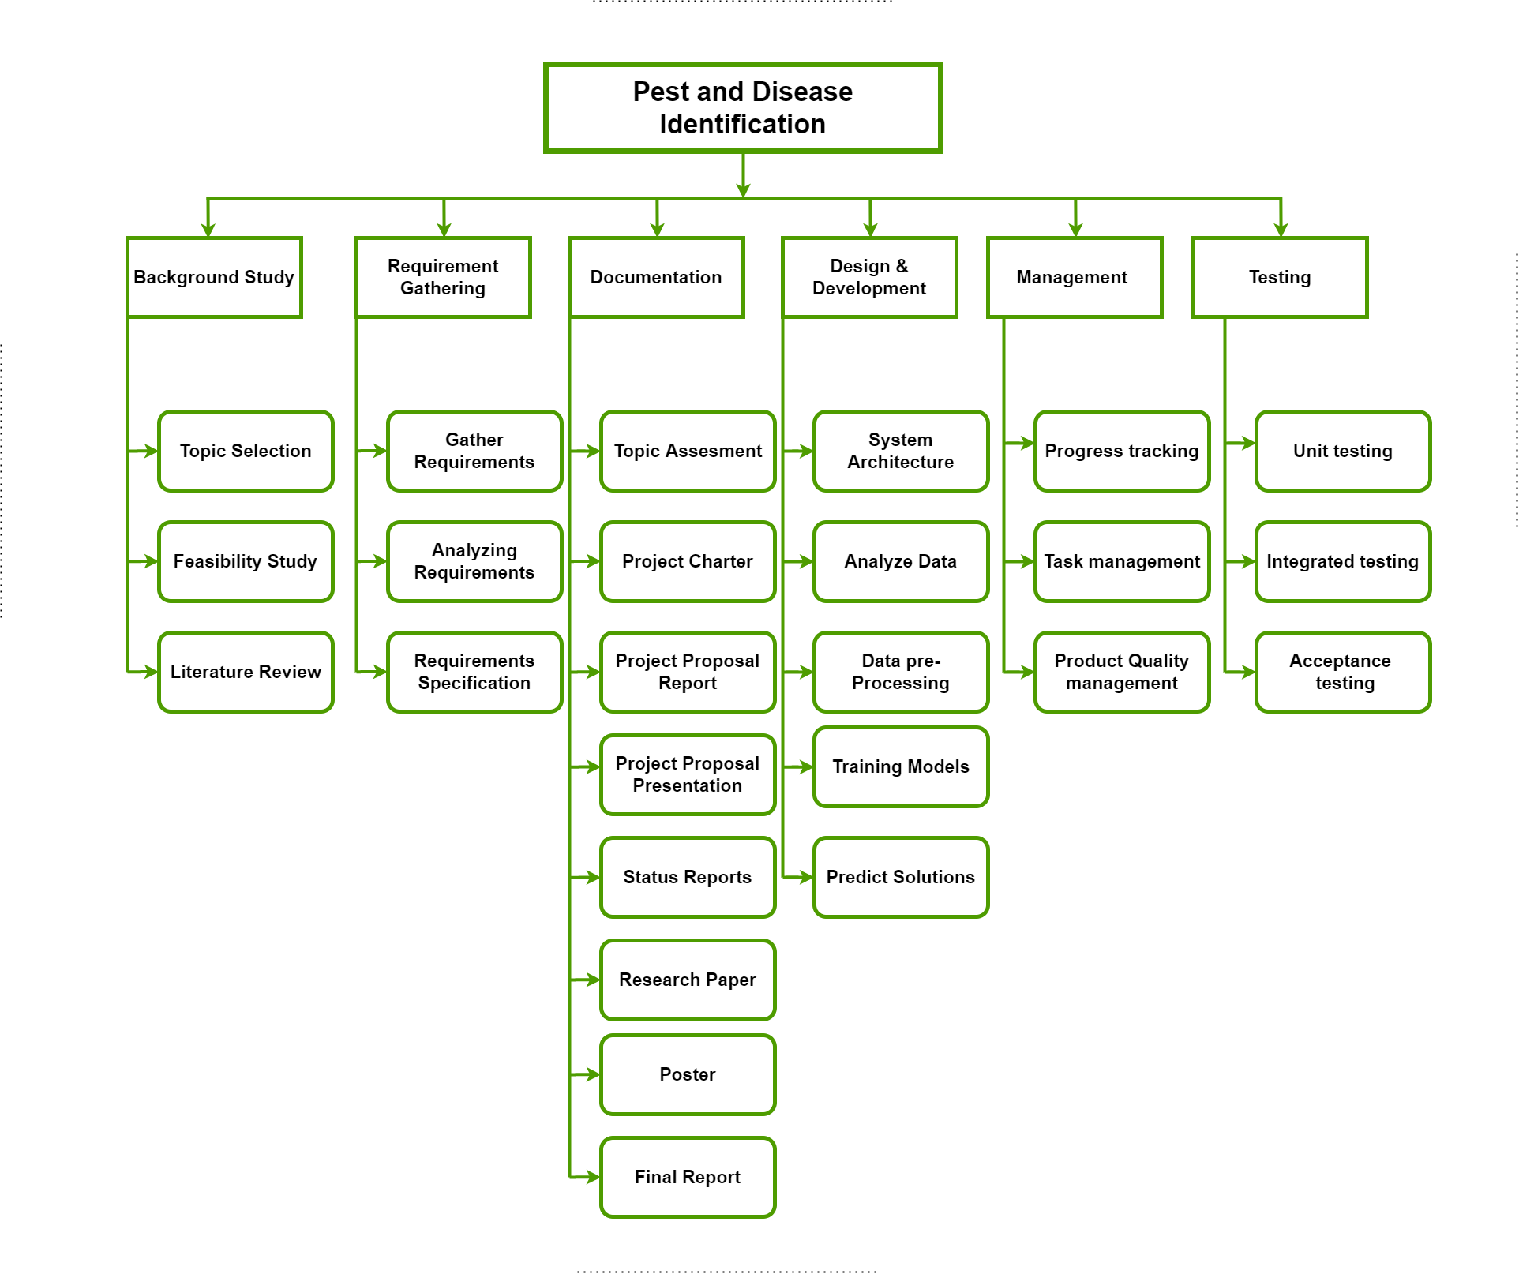
WBS Chart
IT19101620 | Salika Madhushanka W.J | 2022-81

Slide 26
Grant Chart
IT19101620 | Salika Madhushanka W.J | 2022-81

Slide 27
References
[1] “Crop Loss Assessment in Rice: Papers given at the International Workshop on Crop Loss Assessment to Improve Pest Management in Rice and Rice-Based Cropping Systems in South and Southeast Asia, 11-17 October 1987.” Google Books, Int. Rice Res. Inst., 1990, books.google.lk/books?id=yz0T2jVWS6MC&. Accessed 31 Jan. 2022.
[2] “Agrio - Protect your crops. Harvest more! - Apps on Google Play,” Google. [Online]. Available: https://play.google.com/store/apps/details?id=com.agrio&hl=en_US. [Accessed: 20- Feb-2020].
[3] “Crop Farmers App - Apps on Google Play,” Google. [Online]. Available: https://play.google.com/store/apps/details?id=com.bivatec.cropfarmersguide&hl=en_US. [Accessed: 20-Feb-2020].
[4] Rittika Raichaudhuri and Rashmi Sharma. [Online]. Available: Imaging-Based-Method-for-Precursors-of-Impending-Disease-from-Blood-Traces.pdf (researchgate.net).
[5] Johnny L. Miranda, B. Gerardo [Online]. Available: [PDF] Pest Identification using Image Processing Techniques in Detecting Image Pattern through Neural Network | Semantic Scholar. [Accessed: 20-Feb-2020].
[6] “Pest & Crop App - Apps on Google Play,” Google. [Online]. Available: Pest & Crop Management - Apps on Google Play [Accessed: 20-Feb-2020].
IT19101620 | Salika Madhushanka W.J | 2022-81

Slide 28

IT19117256 | P.Y.D Jayasinghe
Software Engineering
IT19117256 | P.Y.D Jayasinghe | 2022-81

Slide 29
Introduction
Background
Research Gap
Research Problem
Objectives

Slide 30
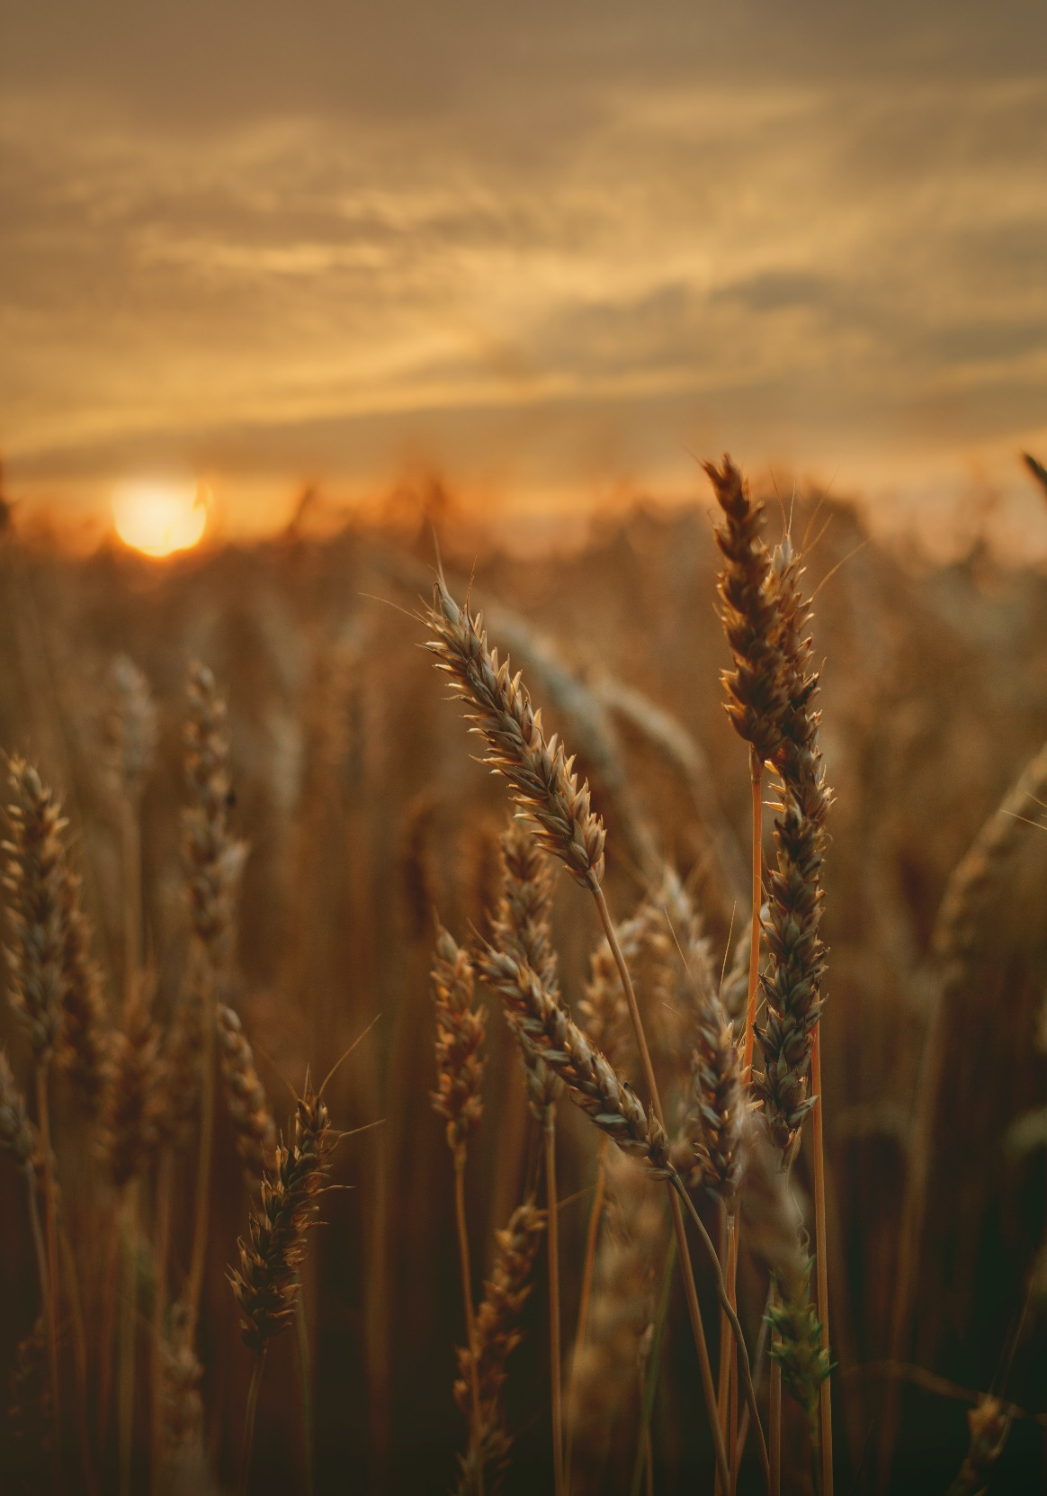
Background
What are the weeds?
How do weeds affect the productivity of rice?
The current technology that is used.
IT19117256 | P.Y.D Jayasinghe | 2022-81

Slide 31
Yield losses due to weed [1]

Slide 32
Economic losses due to weeds (USD in million) [2]

Slide 33
Research Gap
Task | Real-time Deep Neural Network [3] | Weed and Wheat Image Processing [4] | Remote Sensing in Rice Fields [5] | Automated Stereo Computer-Vision [6] | ID Weeds [7] | E-Ketha
Weed Detection | ✓ | ✓ | ✓ | ✓ | ✗ | ✓
Rice Centric | ✗ | ✗ | ✓ | ✓ | ✗ | ✓
Aerial Imagery Used | ✓ | ✓ | ✓ | ✗ | ✗ | ✓
Classify Weed | ✗ | ✗ | ✓ | ✓ | ✓ | ✓
Propose Solution | ✓ | ✗ | ✗ | ✗ | ✓ | ✓
Preparation Needed | ✗ | ✗ | ✓ | ✓ | ✗ | ✗
IT19117256 | P.Y.D Jayasinghe | 2022-81

Slide 34
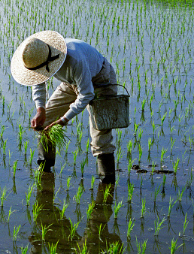
Research Problems
Identification of weeds difficult in large fields.
Handling of weeds without proper knowledge being difficult.
The quick spreading of weeds.
Some popular weedicide being harmful for crops.
IT19117256 | P.Y.D Jayasinghe | 2022-81

Slide 35
Main Objective
Identification of weeds and provide solutions

Slide 36
Scan the aerial image
Sub Objectives
Provide solution
Provide solution
Identify the weeds
Scan the weed images
Map the weeds from aerial images

Slide 37
Methodology
System Diagram
Technologies
Requirements
WBS

Slide 38
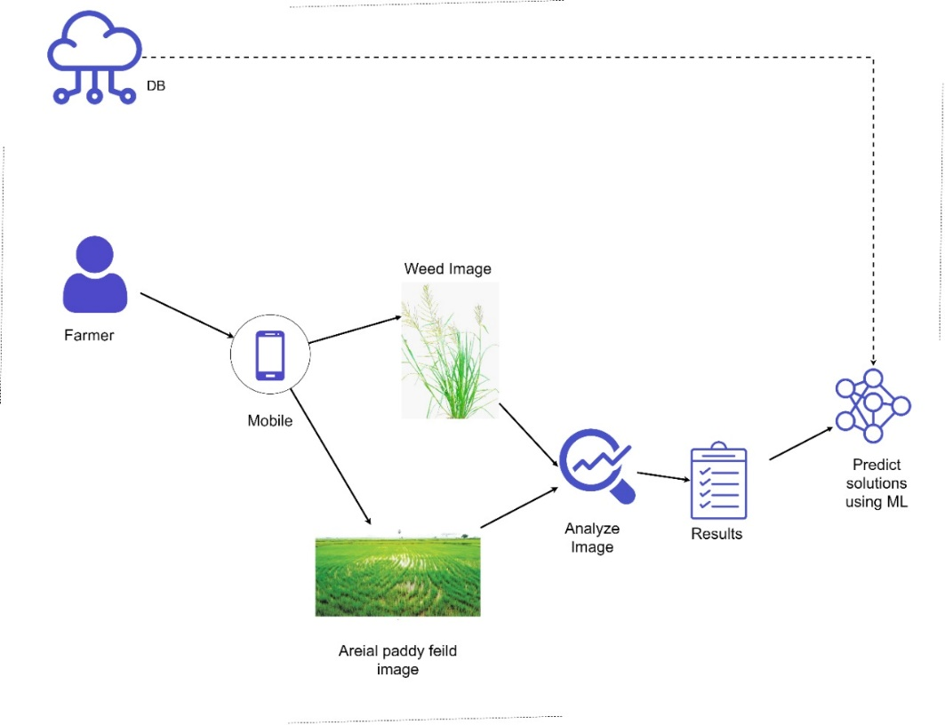
System Diagram
IT19117256 | P.Y.D Jayasinghe | 2022-81

Slide 39
Technologies

Slide 40
Chosen Architectures
Image classification –
CNN
ResNet
DenseNet
FractalNet
Image segmentation –
Patch classification
FCN
SegNet
U-net

Slide 41
CNN - Comparison
ResNet | DenseNet
Correlated features | Diversified features
Require more parameters | Require fewer parameters

Slide 42
FCN - Comparison
SegNet | U-net
Only the pooling indices are transferred to the expansion path from the compression path | Entire feature maps are transferred from compression path to expansion path
Uses less memory | Uses more memory
Three convolution blocks | Five convolution blocks
Computationally efficient | Higher computational time for training

Slide 43
Requirements
System requirements
Average processing power (2GHz)
Average RAM (2GB)
Average storage memory 1GB free
Internet connection
Non-functional requirements
Reliability
Availability
Performance
Personal requirements
Basic smartphone knowledge
IT19101620 | Salika Madhushanka W.J | 2022-81

Slide 44
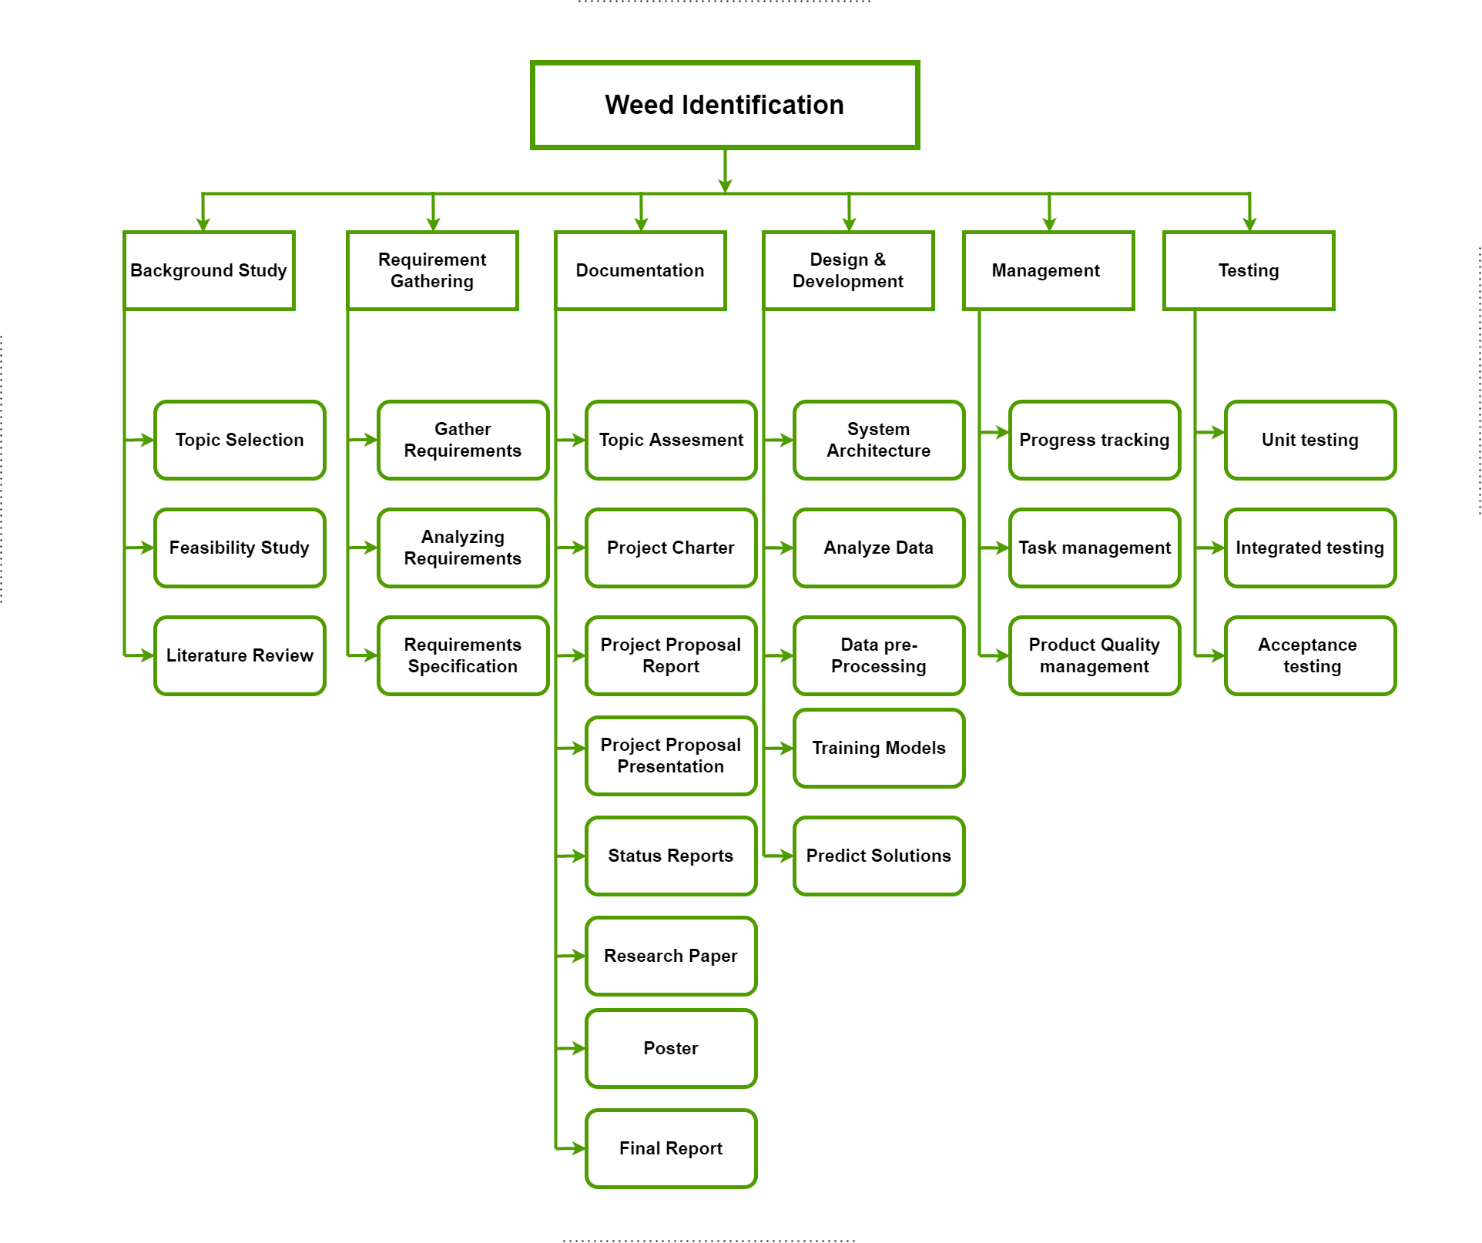
WBS Chart
IT19117256 | P.Y.D Jayasinghe | 2022-81

Slide 45
Grant Chart
IT19117256 | P.Y.D Jayasinghe | 2022-81

Slide 46
References
[1] Shekhawat, Kapila, et al. “Weed Management in Dry Direct-Seeded Rice: A Review on Challenges and Opportunities for Sustainable Rice Production.” Agronomy, vol. 10, no. 9, 26 Aug. 2020, p. 1264, 10.3390/agronomy10091264. Accessed 28 Sept. 2020.
[2] Gharde, Yogita, et al. “Assessment of Yield and Economic Losses in Agriculture due to Weeds in India.” Crop Protection, vol. 107, May 2018, pp. 12–18, 10.1016/j.cropro.2018.01.007.
[3] Rakhmatuiln, Ildar, et al. “Deep Neural Networks to Detect Weeds from Crops in Agricultural Environments in Real-Time: A Review.” Remote Sensing, vol. 13, no. 21, 8 Nov. 2021, p. 4486, 10.3390/rs13214486. Accessed 12 Dec. 2021.
[4] “(PDF) Detection of Weed and Wheat Using Image Processing,” www.researchgate.net. https://www.researchgate.net/publication/330796498_Detection_of_Weed_and_Wheat_Using_Image_Processing (accessed Jan. 24, 2022)
[5] Rosle, Rhushalshafira, et al. “Weed Detection in Rice Fields Using Remote Sensing Technique: A Review.” Applied Sciences, vol. 11, no. 22, 1 Jan. 2021, p. 10701, www.mdpi.com/2076-3417/11/22/10701, 10.3390/app112210701. Accessed 24 Jan. 2022.
[6] Dadashzadeh, Mojtaba, et al. “Weed Classification for Site-Specific Weed Management Using an Automated Stereo Computer-Vision Machine-Learning System in Rice Fields.” Plants, vol. 9, no. 5, 1 May 2020, p. 559, www.mdpi.com/2223-7747/9/5/559, 10.3390/plants9050559. Accessed 24 Jan. 2022.
IT19117256 | P.Y.D Jayasinghe | 2022-81

Slide 47

IT19129372 | h.h.w.m.Binuka Sihan paranagamA
Software Engineering
IT19129372 | H.H.W.M.Binuka Sihan Paranagama | 2022-81

Slide 48
Introduction
Background
Research Gap
Research Problem
Objectives

Slide 49
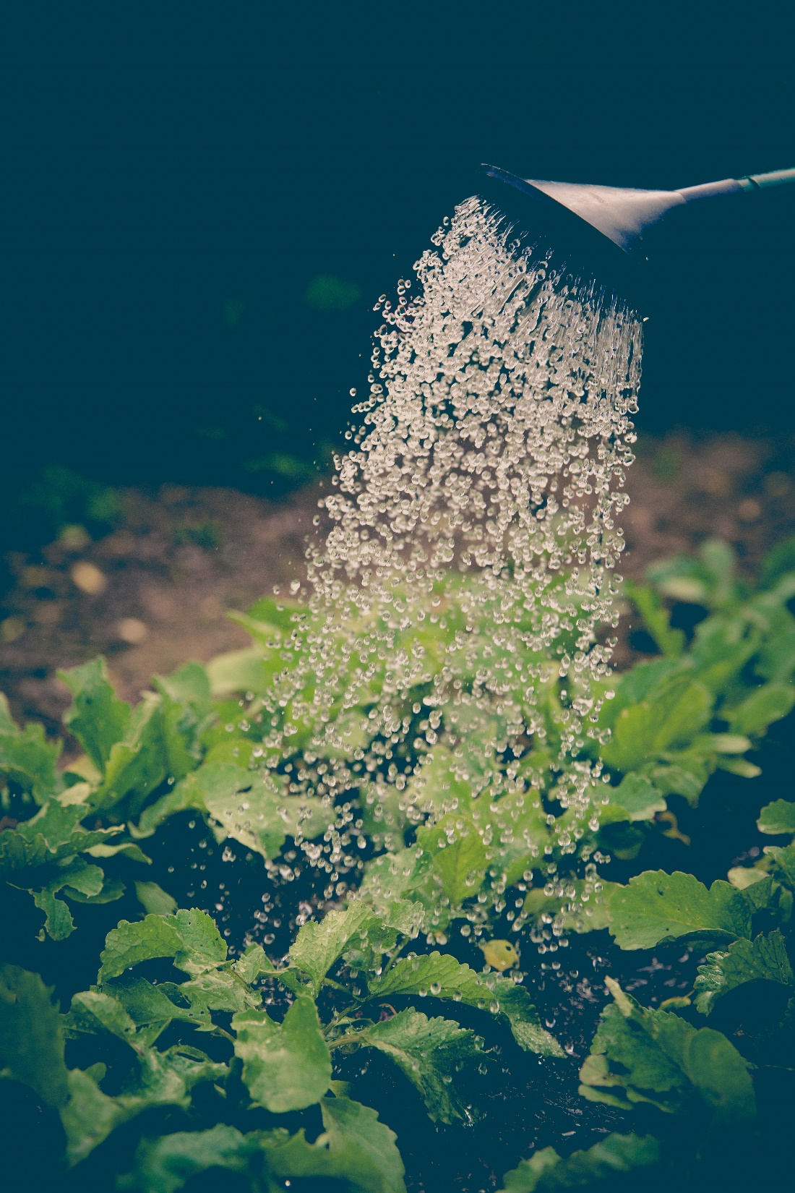
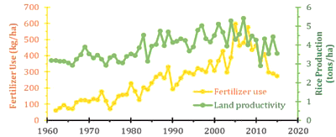
Background
What are the fertilizer?
Why fertilizer used rice production?
[2]
[2]
IT19129372 | H.H.W.M.Binuka Sihan Paranagama | 2022-81

Slide 50

What is the Problem?

Slide 51

Research Problem
Fertilizer Overuse
Affected areas :
Damage Crops
Environmental issues
Health Concerns
Soil pollution
[1]
IT19129372 | H.H.W.M.Binuka Sihan Paranagama | 2022-81

Slide 52
Research Gap
Task | Nutrient recommendation system [3] | On-line fertilizer recommendation [4] | Prediction of Crop Fertilizer [5] | iFMS [6] | E-Ketha
Calculate paddy area | ✗ | ✗ | ✗ | ✗ | ✓
Identify fertilizer | ✗ | ✗ | ✗ | ✗ | ✓
Recommend fertilizer | ✓ | ✗ | ✗ | ✗ | ✓
limited fertilizer range | ✓ | ✗ | ✓ | ✗ | ✗
Able to use for rice plant | ✓ | ✓ | ✗ | ✗ | ✓
Provide guidance | ✓ | ✓ | ✓ | ✗ | ✓
Monitor fertilizer sales | ✗ | ✗ | ✗ | ✓ | ✗
IT19129372 | H.H.W.M.Binuka Sihan Paranagama | 2022-81

Slide 53
Main Objective
Proper management of fertilizers use

Slide 54
Calculate paddy field area
Sub Objectives
Provide guidance
Scan the fertilizer
Identify the fertilizer type and variety

Slide 55
Methodology
System Diagram
Technologies
Requirements
WBS

Slide 56
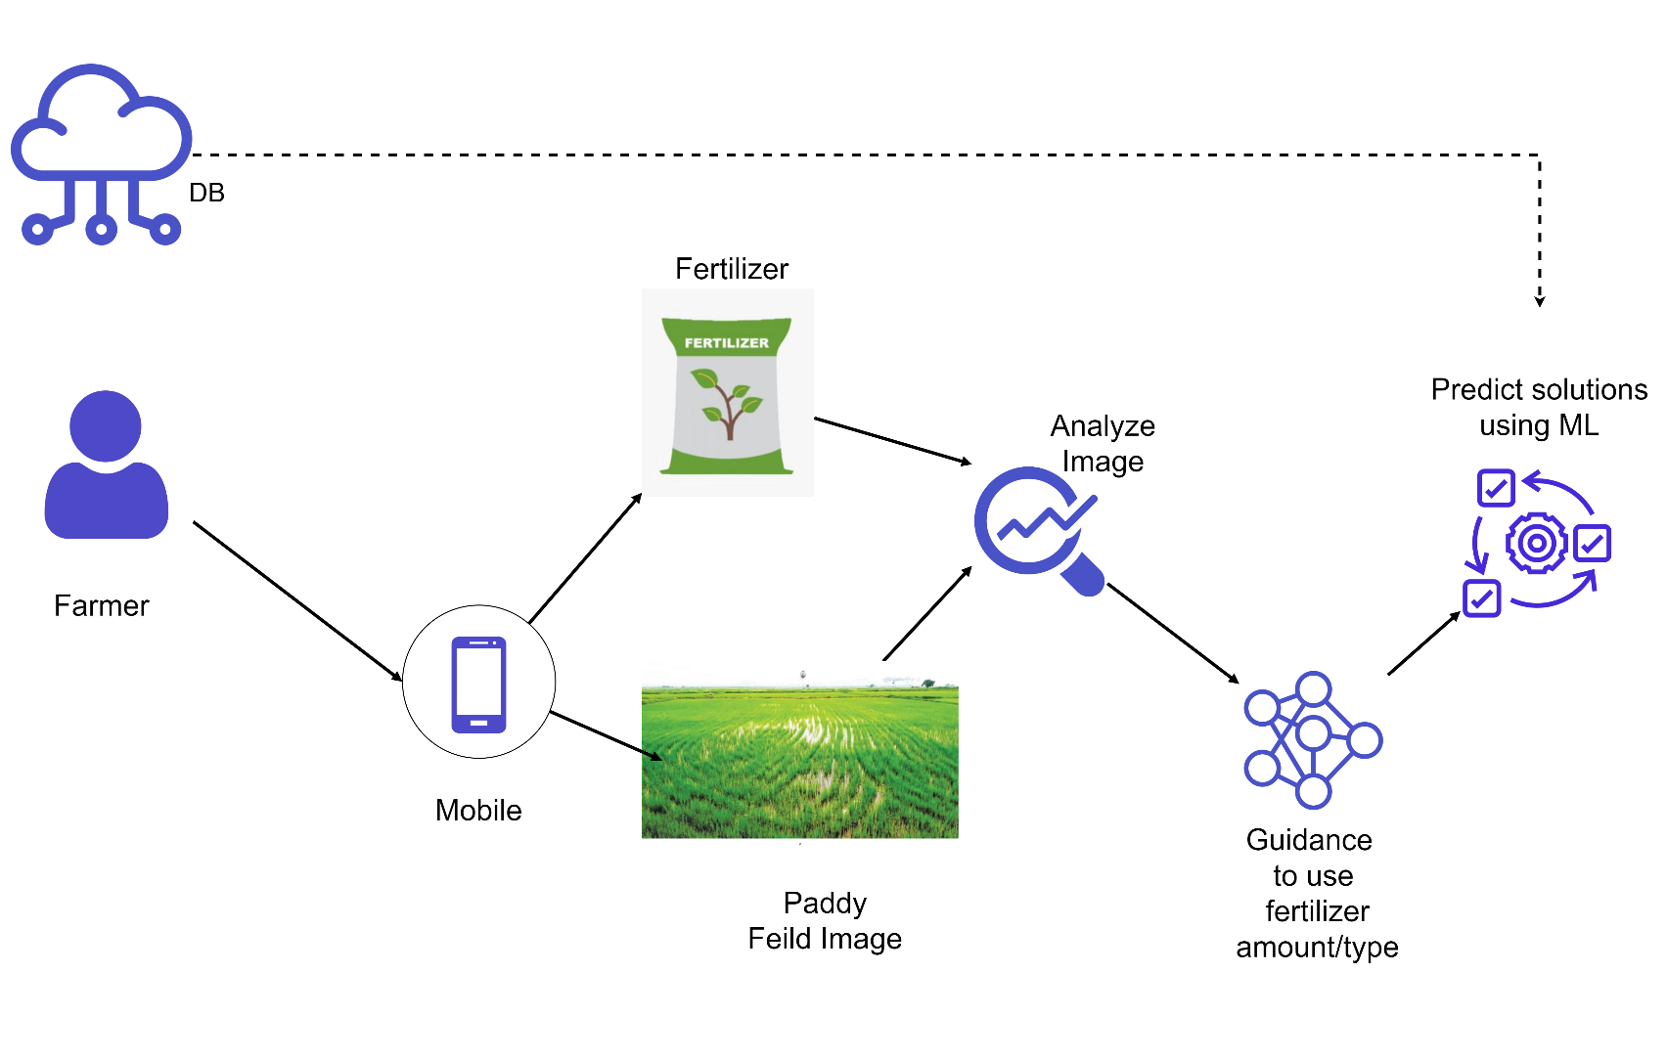
System Diagram
IT19129372 | H.H.W.M.Binuka Sihan Paranagama | 2022-81

Slide 57
Technologies

Slide 58
Chosen Architectures
Image classification –
CNN
CV-CNN
SRCNN
Object detection –
Fast R-CNN
Faster R-CNN
Region-based Convolutional Neural Networks (R-CNN)
Region-based Fully Convolutional Network (R-FCN)
Single Shot Detector (SSD)
YOLO (You Only Look Once)

Slide 59
CNN - Comparison
ResNet | DenseNet
Correlated features | Diversified features
Require more parameters | Require fewer parameters

Slide 60
Requirements
System requirements
Average processing power (2GHz)
Average RAM (2GB)
Average storage memory 1GB free
Internet connection
Non-functional requirements
Reliability
Availability
Performance
Personal requirements
Basic smartphone knowledge
IT19101620 | Salika Madhushanka W.J | 2022-81

Slide 61

WBS Chart

Slide 62
Grant Chart
IT19129372 | H.H.W.M.Binuka Sihan Paranagama | 2022-81

Slide 63
References
[1] “දිනමිණ EPaper : Dinamina Online EEdition - Lake House - Sri Lanka.” Archives.dinamina.lk, archives.dinamina.lk/epaper/?tday=2013/12/09. Accessed 31 Jan. 2022.
[2] “Organic-Fertiliser-Only Policy Will Plunge Lanka into a Food Crisis.” Print Edition - the Sunday Times, Sri Lanka, www.sundaytimes.lk/210509/sunday-times-2/organic-fertiliser-only-policy-will-plunge-lanka-into-a-food-crisis-442857.html.
[3] “Computers and Electronics in Agriculture | Journal | ScienceDirect.com by Elsevier,” www.sciencedirect.com. https://www.sciencedirect.com/journal/computers-and-electronics-in-agriculture (accessed Jul. 31, 2021).
[4] “On-line fertilizer recommendation system.” Web. [Online]. Available: h https://www.nic.in/. [accessed Jul. 31, 2021].
[5] K. Hampannavar, V. Bhajantri, and Shashikumar. G. Totad, “Prediction of Crop Fertilizer Consumption,” IEEE Xplore, Aug. 01, 2018. https://ieeexplore.ieee.org/abstract/document/8697827 (accessed Jan. 23, 2022).
[6] “Integrated Fertilizer Management System (iFMS).” Web. [Online]. Available: https://dbtfert.nic.in/iFMS/. [accessed Jul. 31, 2021].
IT19129372 | H.H.W.M.Binuka Sihan Paranagama | 2022-81

Slide 64

IT19240152 | K.M.Umesh Ranthilina
Software Engineering
IT19240152 | K.M.Umesh Ranthilina | 2022-81

Slide 65
Introduction
Background
Research Gap
Research Problem
Objectives

Slide 66

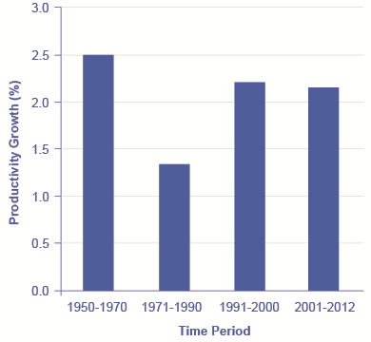
Background
What is growth of the plant?
How do growth affect the productivity of rice?
Why height is so important?
IT19240152| Umesh Ranthilina K.M| 2022-81

Slide 67
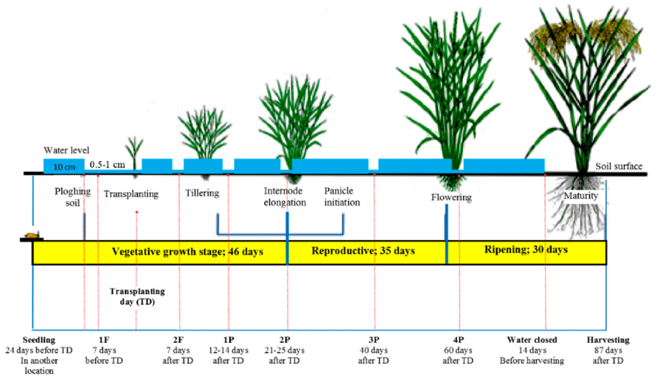
Stages of rice plant growth
IT19240152 | K.M.Umesh Ranthilina | 2022-81

Slide 68
Research Gap
Task | Rice Crop Height Measurement [3] | UAV-Based LIDAR [1,2] | Time-lapse camera [4] | Measurement of heights of rice and tiller fragmentation [5] | E-Ketha
Height measurement | ✓ | ✓ | ✓ | ✓ | ✓
Growth phase deduction | ✓ | ✗ | ✓ | ✗ | ✓
Aerial Imagery Used | ✗ | ✓ | ✗ | ✗ | ✗
classify rice plant height | ✗ | ✗ | ✗ | ✗ | ✓
Propose Solution on how to growth of the plant | ✓ | ✗ | ✓ | ✗ | ✓
IT19240152 | Umesh Ranthilina K.M| 2022-81

Slide 69
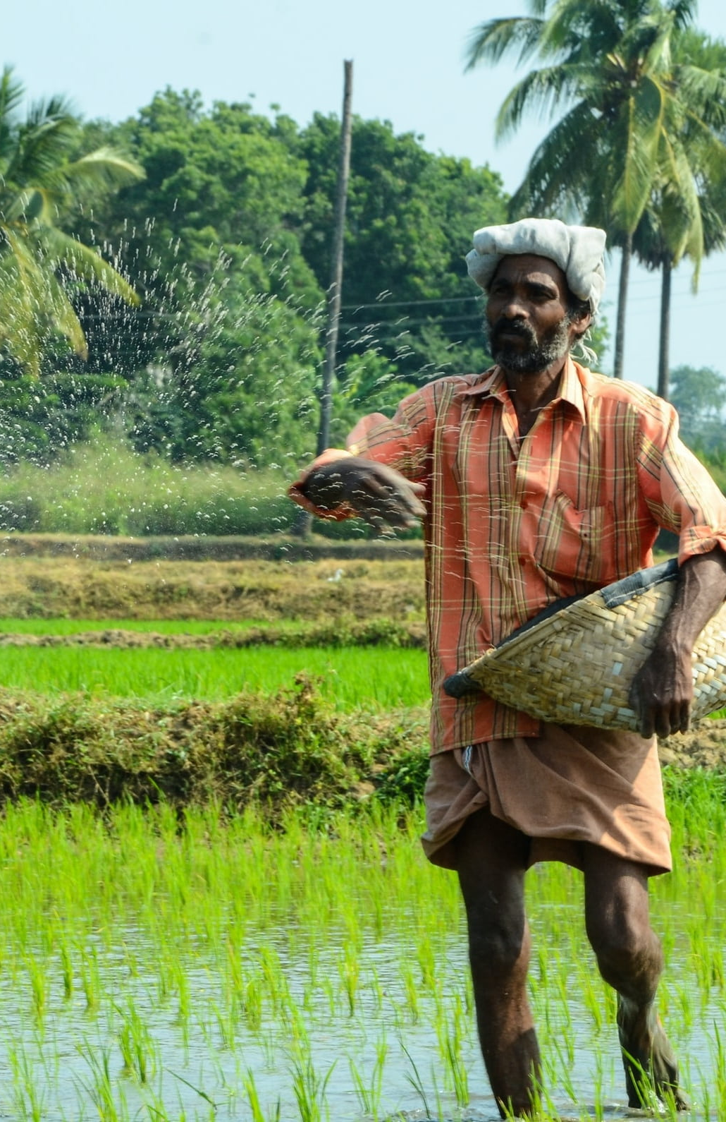
Research Problems
Identification of growth deficiency being difficulty.
Finding the reasons without proper knowledge being difficult.
Some fertilizer not responding properly to crops.
IT19240152| Umesh Ranthilina K.M| 2022-81

Slide 70
Main Objective
Identification of growth deficiency

Slide 71
Scan the image
Sub Objectives
Provide solution
Calculate the growth
Identify the height of the plant

Slide 72
Methodology
System Diagram
Technologies
Requirements
WBS

Slide 73
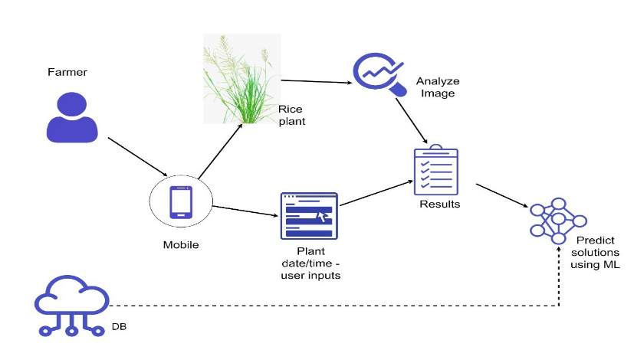
System Diagram
IT19240152 | K.M.Umesh Ranthilina | 2022-81

Slide 74
Technologies

Slide 75
Chosen Architectures
Object detection –
Fast R-CNN
Faster R-CNN
Region-based Convolutional Neural Networks (R-CNN)
Region-based Fully Convolutional Network (R-FCN)
Single Shot Detector (SSD)
YOLO (You Only Look Once)

Slide 76
Requirements
System requirements
Average processing power (2GHz)
Average RAM (2GB)
Average storage memory 1GB free
Internet connection
Non-functional requirements
Reliability
Availability
Performance
Personal requirements
Basic smartphone knowledge
IT19101620 | Salika Madhushanka W.J | 2022-81

Slide 77

WBS Chart

Slide 78
Grant Chart
IT19240152 | K.M.Umesh Ranthilina | 2022-81

Slide 79
References
[1] Zhang, Lei, and Tony E. Grift. “A LIDAR-Based Crop Height Measurement System for Miscanthus Giganteus.” Computers and Electronics in Agriculture, vol. 85, 1 July 2012, pp. 70–76, www.sciencedirect.com/science/article/abs/pii/S0168169912000877?via%3Dihub, 10.1016/j.compag.2012.04.001. Accessed 24 Jan. 2022.
[2] ten Harkel, Jelle, et al. “Biomass and Crop Height Estimation of Different Crops Using UAV-Based Lidar.” Remote Sensing, vol. 12, no. 1, 18 Dec. 2019, p. 17, 10.3390/rs12010017. Accessed 23 Aug. 2020.
[3] Sritarapipat, Tanakorn, et al. “Automatic Rice Crop Height Measurement Using a Field Server and Digital Image Processing.” Sensors (Basel, Switzerland), vol. 14, no. 1, 7 Jan. 2014, pp. 900–926, www.ncbi.nlm.nih.gov/pmc/articles/PMC3926593/, 10.3390/s140100900. Accessed 24 Jan. 2022.
[4] Mano, Masayoshi. “Precise and Continuous Measurement of Plant Heights in an Agricultural Field Using a Time-Lapse Camera.” Journal of Agricultural Meteorology, vol. 73, no. 3, 2017, pp. 100–108, www.jstage.jst.go.jp/article/agrmet/73/3/73_D-16-00021/_pdf#:~:text=The%20direct%20method%20for%20measuring, 10.2480/agrmet.d-16-00021. Accessed 15 Oct. 2020.
[5] Constantino, Karol Paulette, et al. “Towards an Automated Plant Height Measurement and Tiller Segmentation of Rice Crops Using Image Processing.” Semantic Scholar, 2018, www.semanticscholar.org/paper/Towards-an-Automated-Plant-Height-Measurement-and-Constantino-Gonzales/130b9345f61bd73b896b9c021a93957c6030b786. Accessed 24 Jan. 2022
[6] www.researchgate.net/figure/Growth-phases-of-a-rice-paddy-with-water-fertilizer-and-pesticide-management-Adapted_fig1_336810143.
‌
[7] “Measuring Productivity and Growth Rates | Macroeconomics.” Courses.lumenlearning.com, courses.lumenlearning.com/wm-macroeconomics/chapter/reading-the-new-economy-controversy/.
‌
IT19240152 | Umesh Ranthilina K.M | 2022-81

Slide 80
Commercialization
Advertise to social media
Creating customer packages
Free – With third party Advertisement
Paid – Advertisement free
Recognizing target farmers

Slide 81
BUDJECT
Item or description | Amount
Reports | 2000
Stationary | 5000
Travelling | 7000
Other | 6000
Total | 20000

Slide 82
THANK YOU

Slide 83
Color codes
#9cce39 – light
#6e9226 - dark

